Slide 1


1. Code repository for Classic CGH algorithms
2023/10/31
Jinze Sha
Centre for Molecular Materials, Photonics and Electronics, University of Cambridge

Slide 2

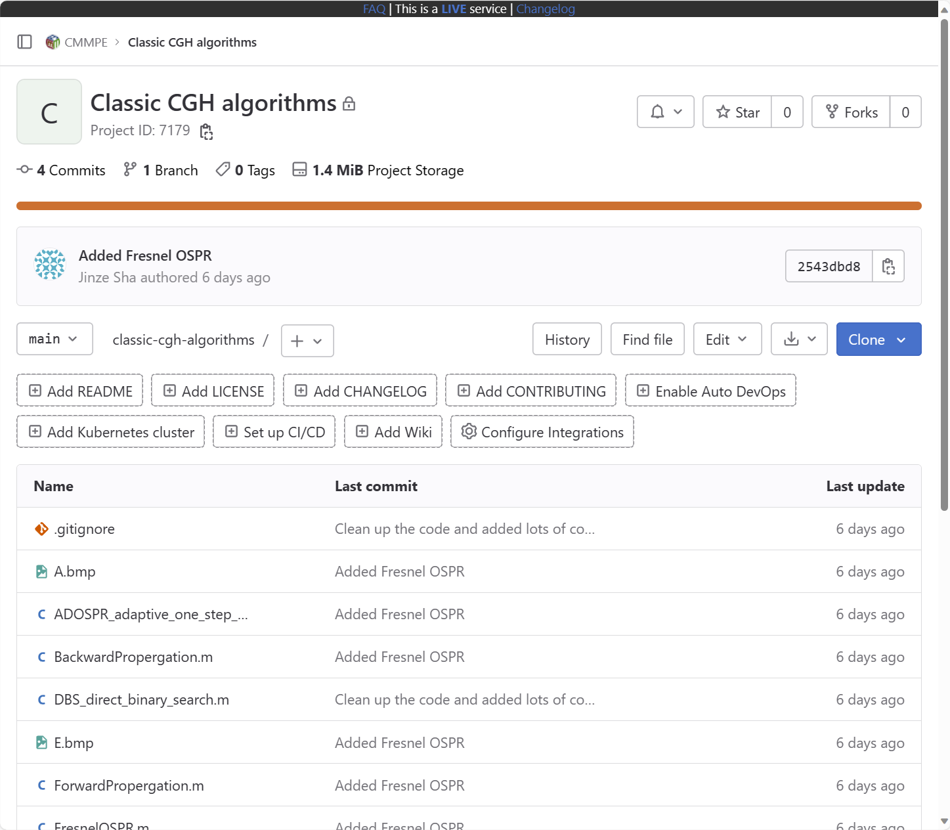
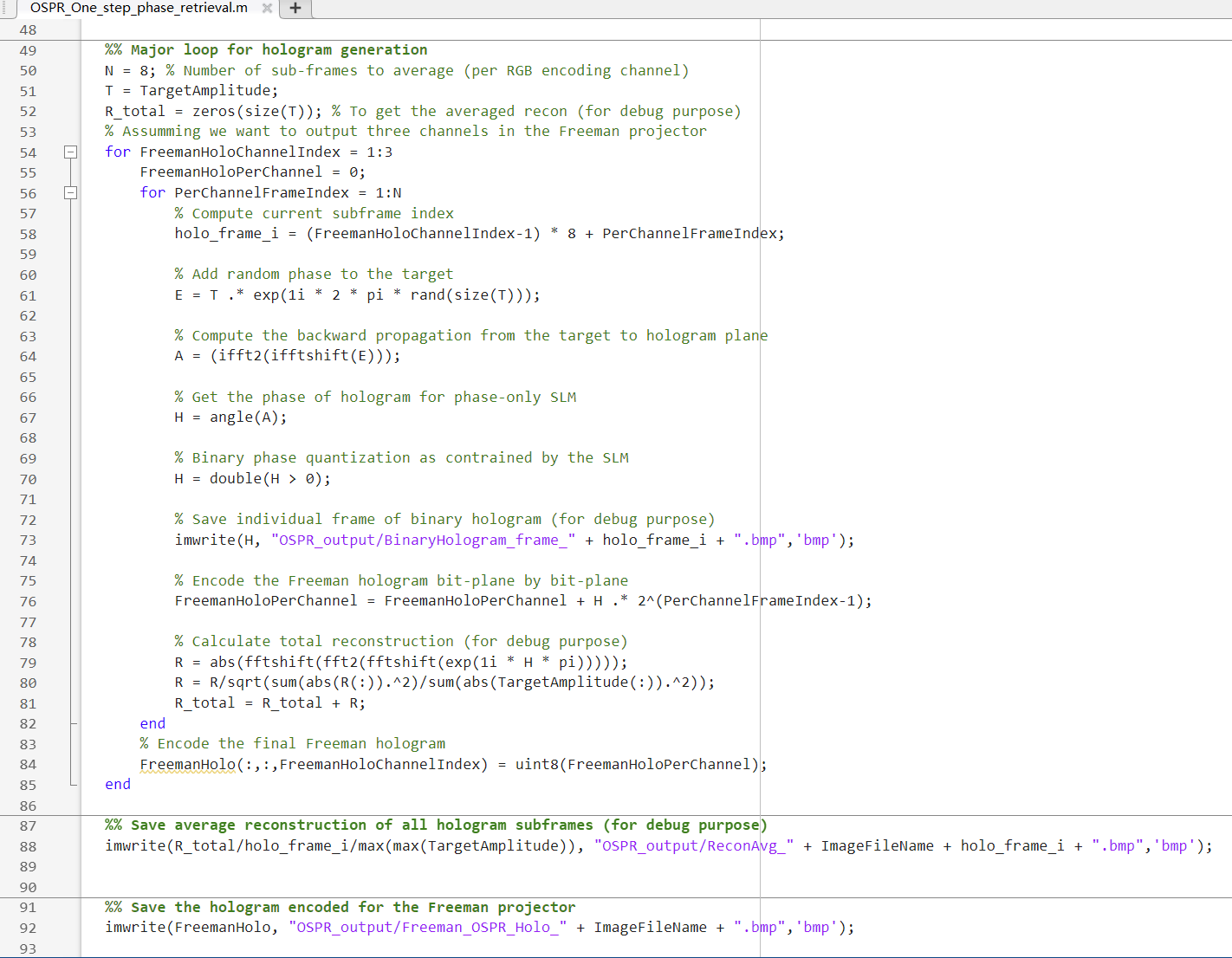
Code repository for Classic CGH algorithms
Link: https://gitlab.developers.cam.ac.uk/eng-cmmpe/classic-cgh-algorithms Please let me know if you have any access issue

Slide 3
Code repository for Classic CGH algorithms
Motivated by the 4th year project students this year
All classic algorithms in one place
DBS, SA, OSPR, ADOSPR, Fresnel OSPR (multi-slice), GS
Code organization and clean up
A lot more comments
Reduce the need of rebuilding the wheels
Please let me know if you see anything dodgy in the code
Link: https://gitlab.developers.cam.ac.uk/eng-cmmpe/classic-cgh-algorithms Please let me know if you have any access issue

Slide 4
2. Update on multi-frame binary hologram optimisation
2023/10/31
Jinze Sha
Centre for Molecular Materials, Photonics and Electronics, University of Cambridge

Slide 5
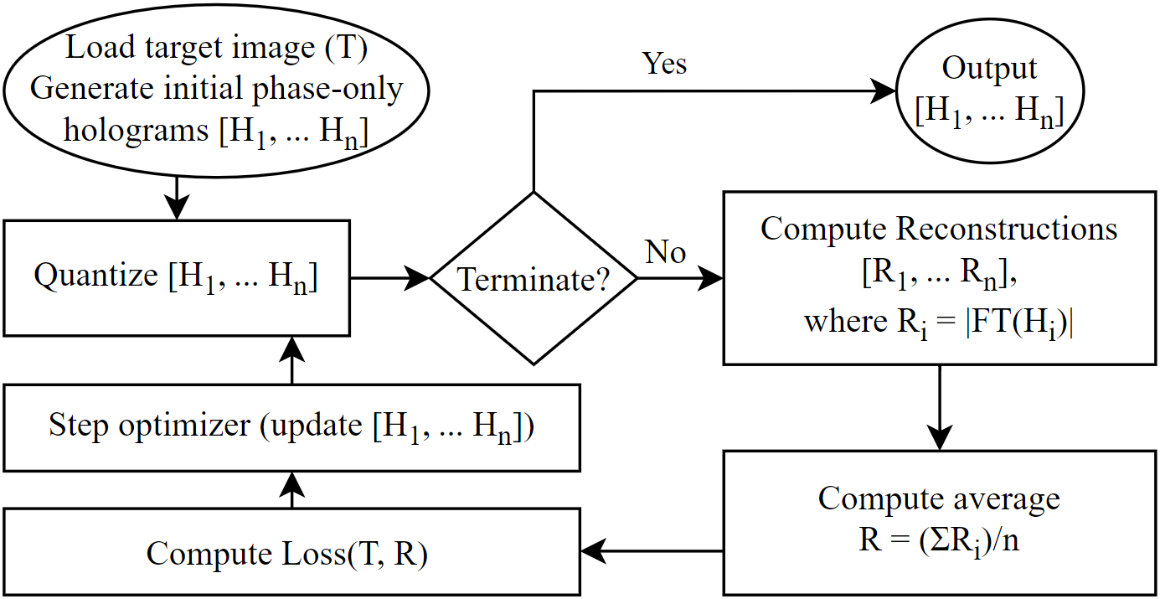
Method

Slide 6

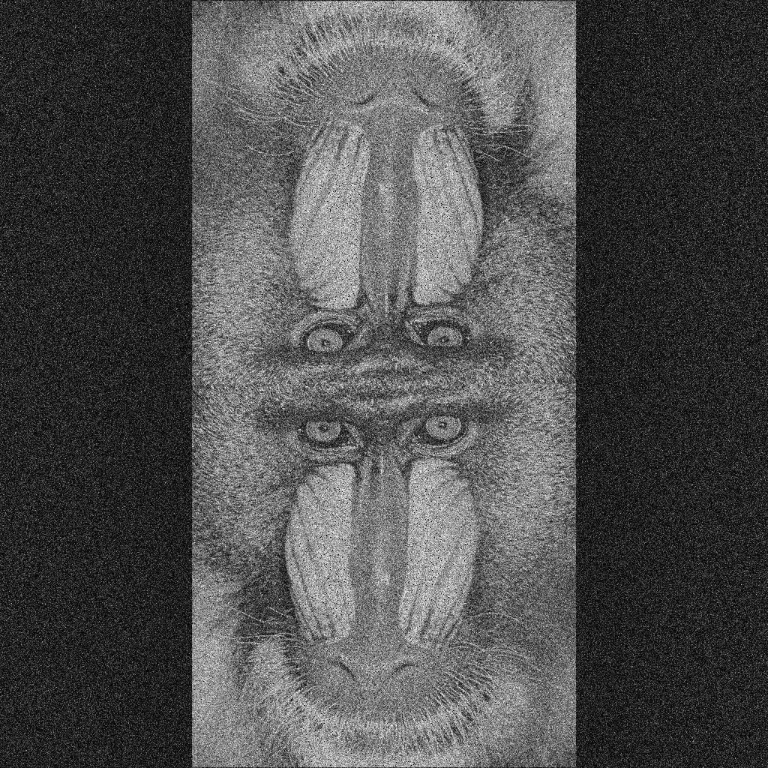

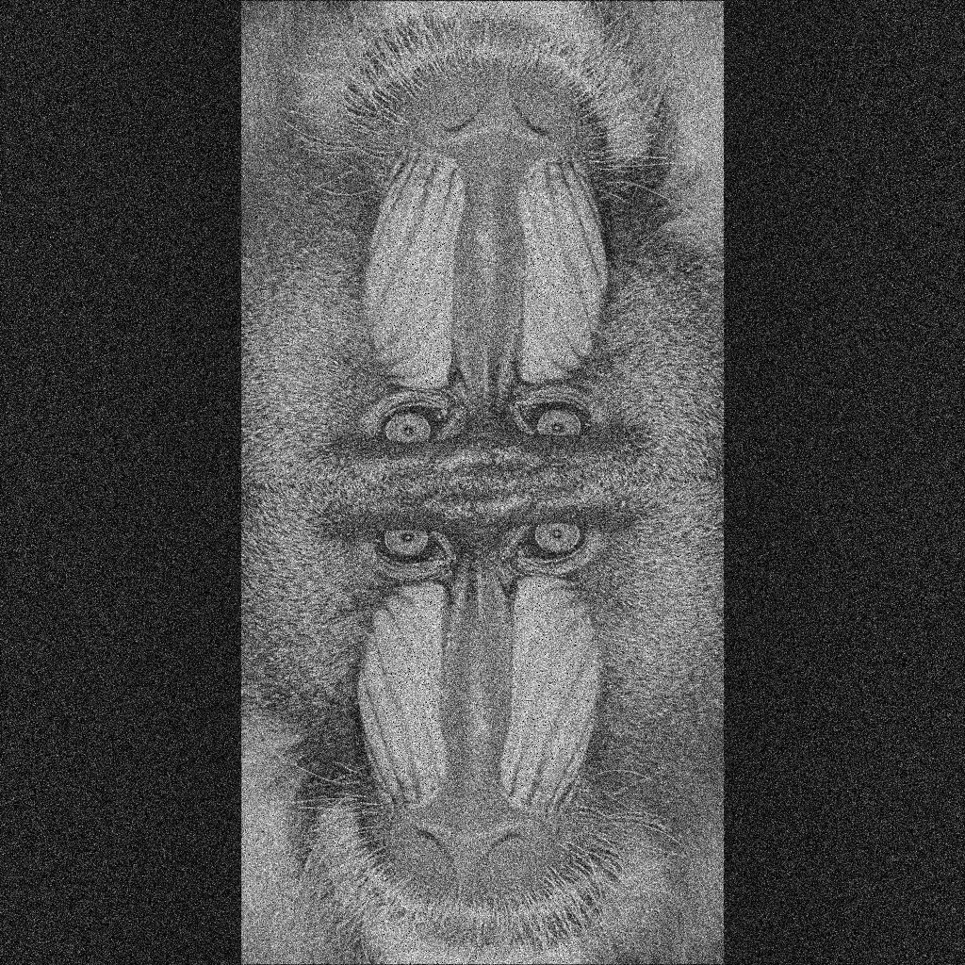
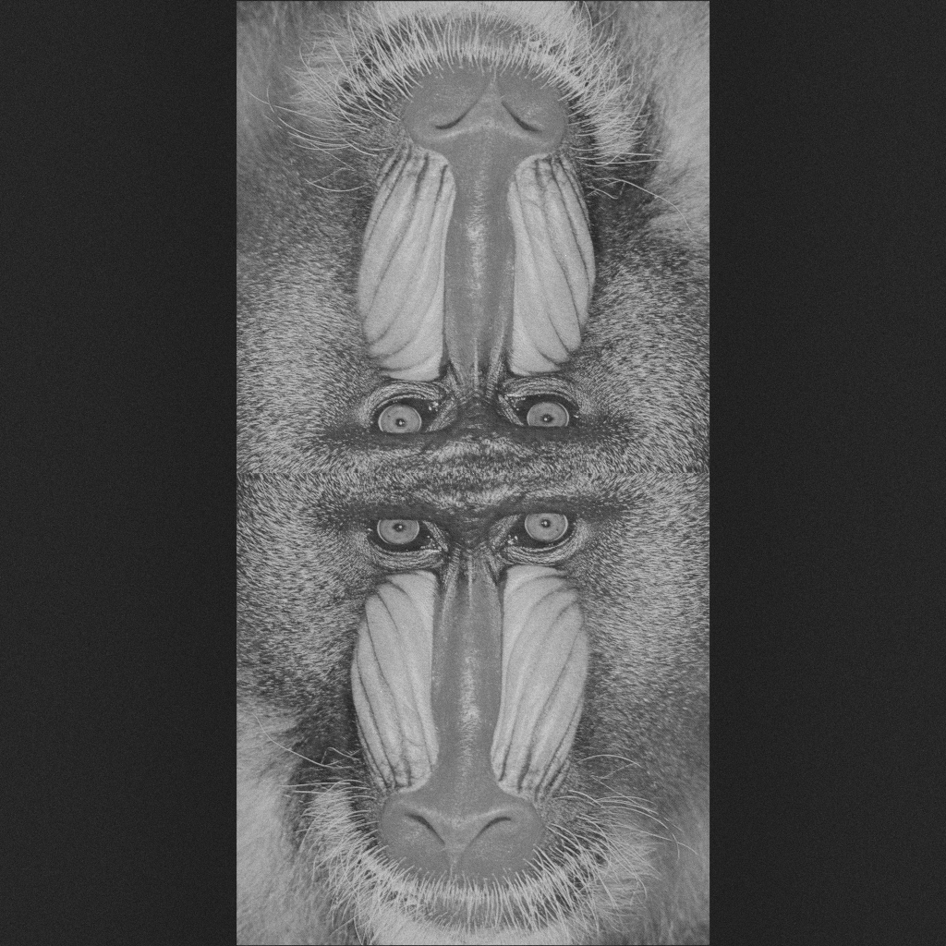
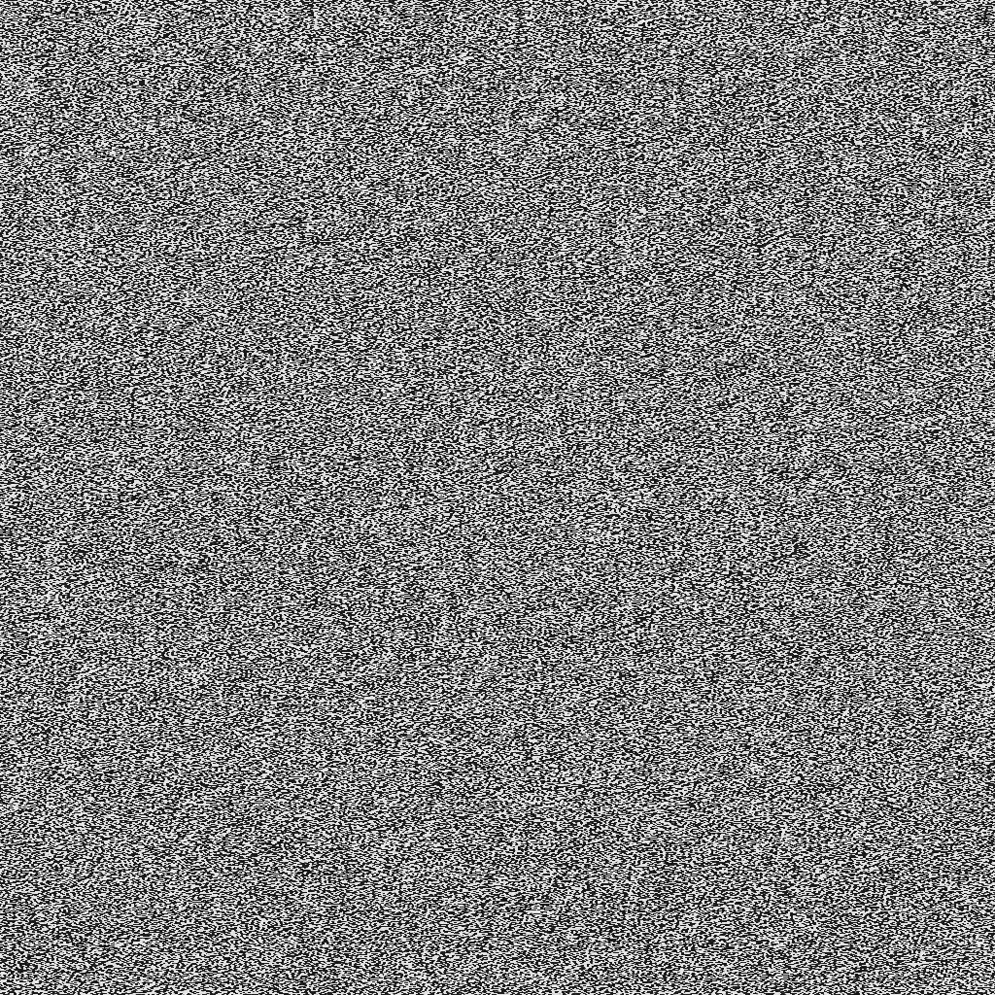
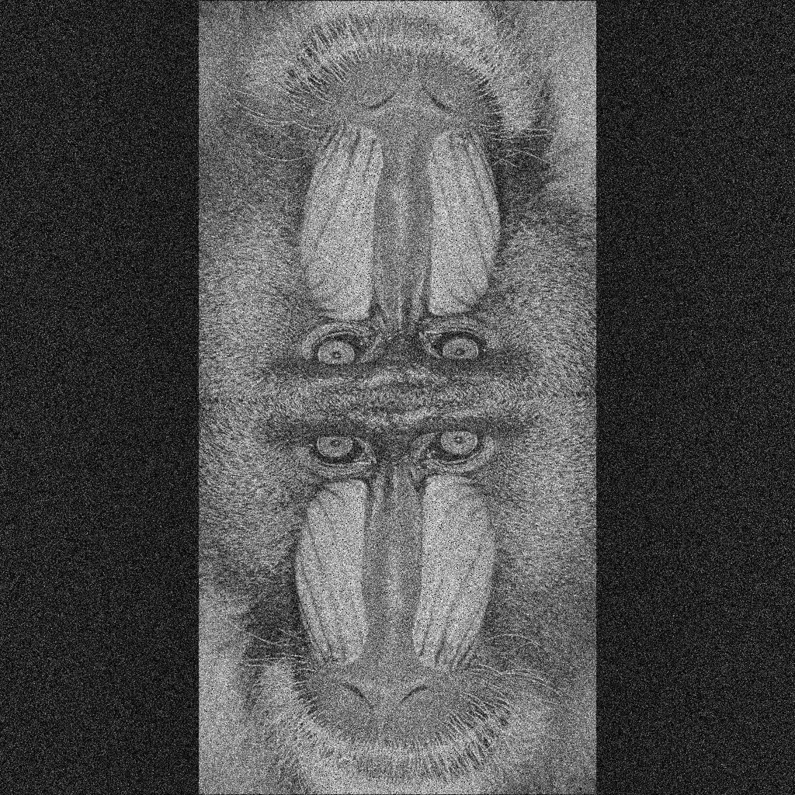

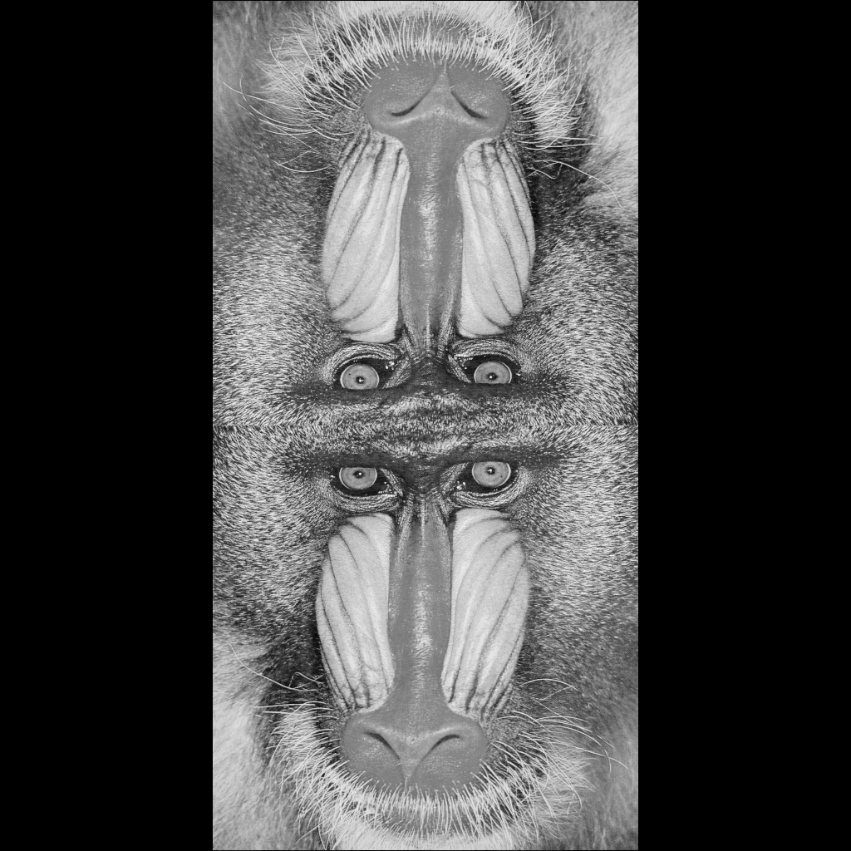

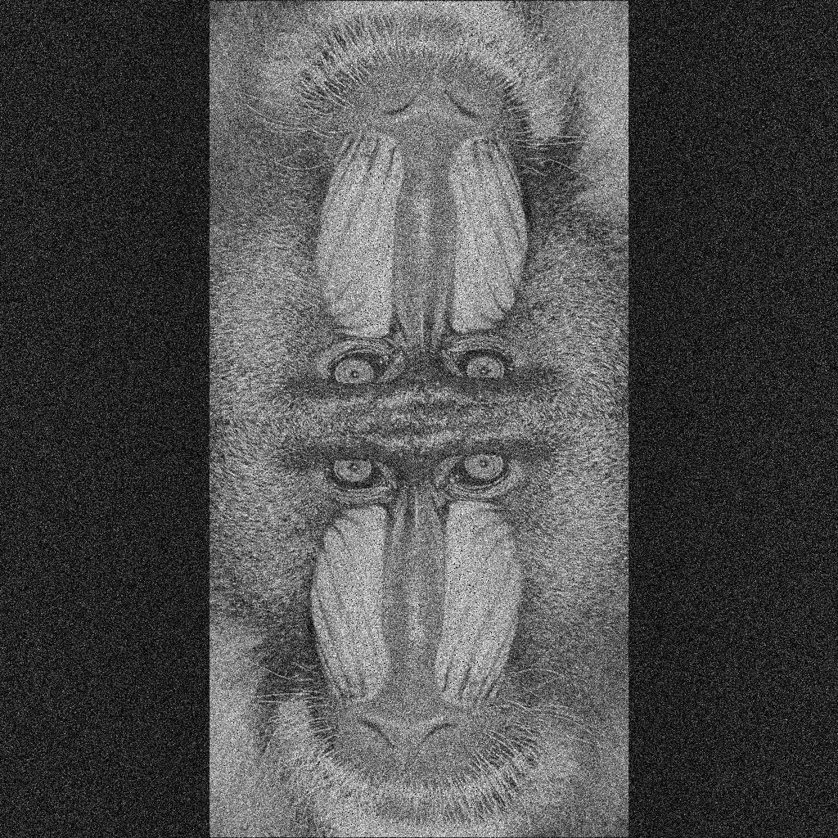
Simulation
FT
FT
24 sub-holograms
FT
Average
Loss( )
…
…
…
FT
Target
Softer Binary quantization using the Sigmoid function

Slide 7
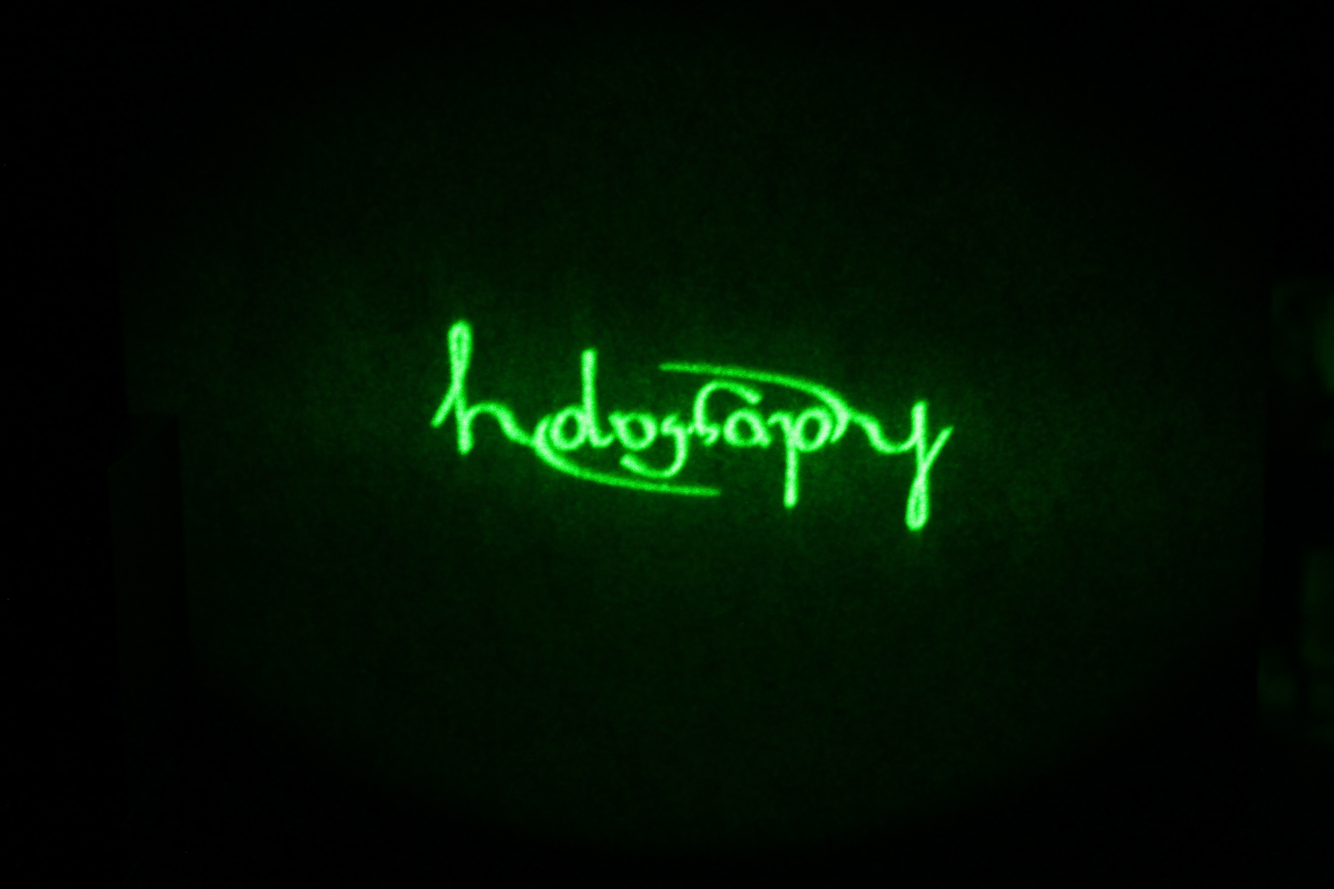
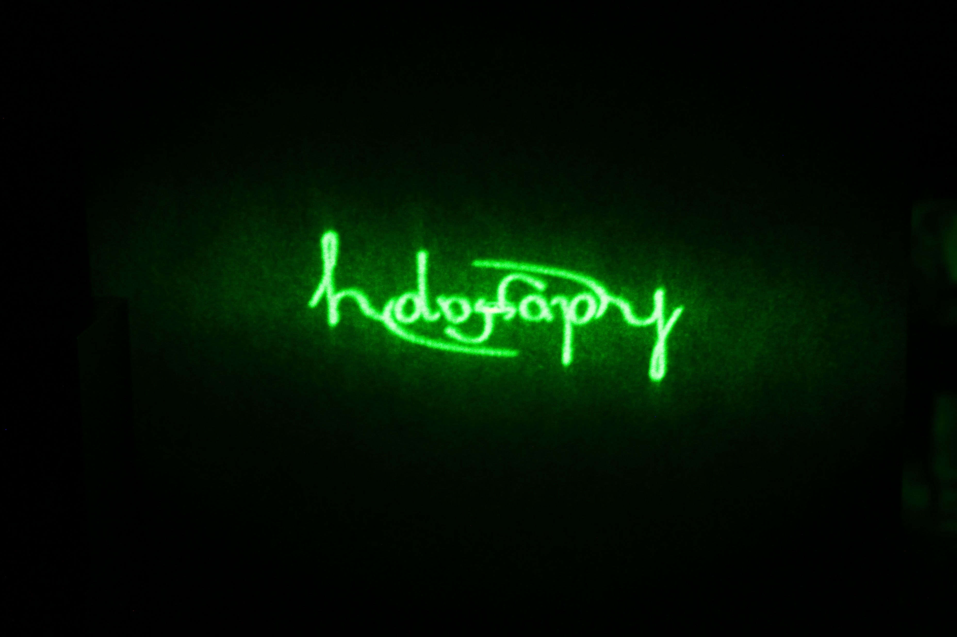
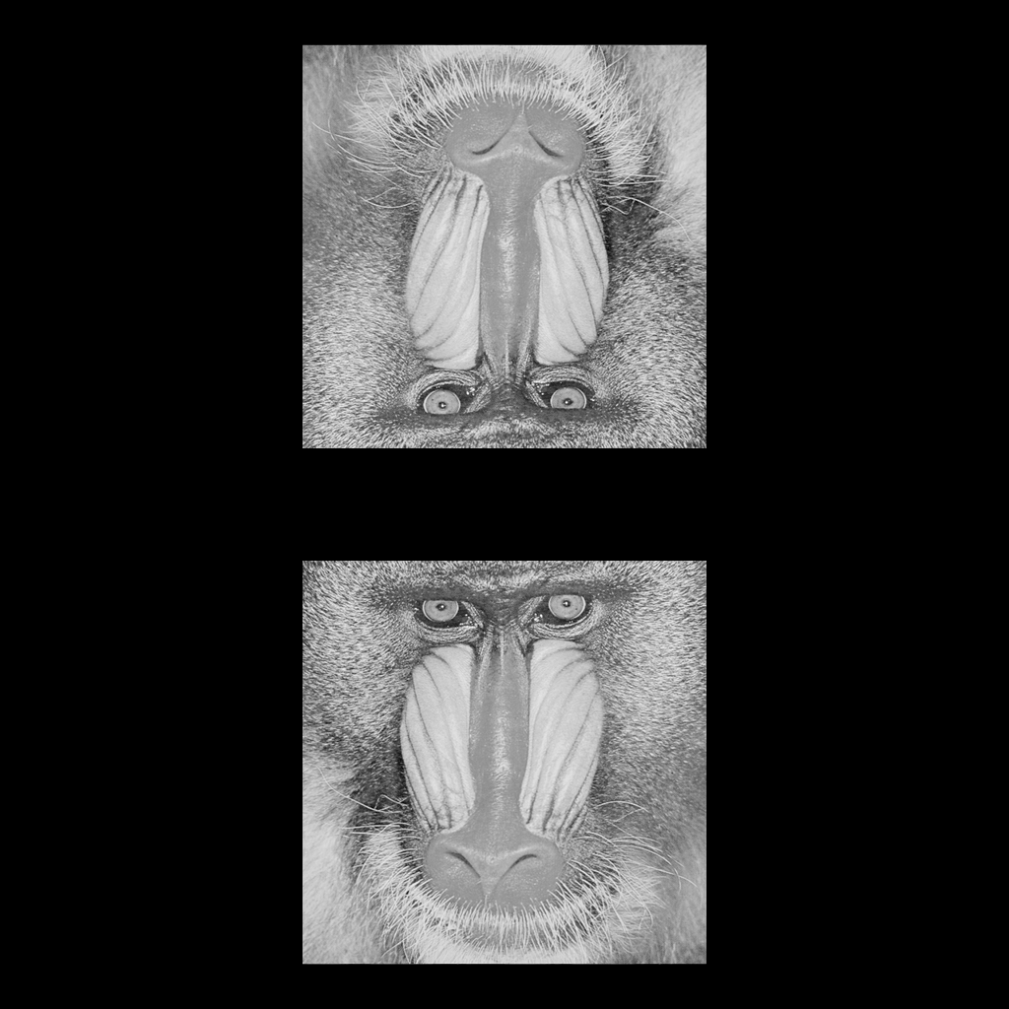
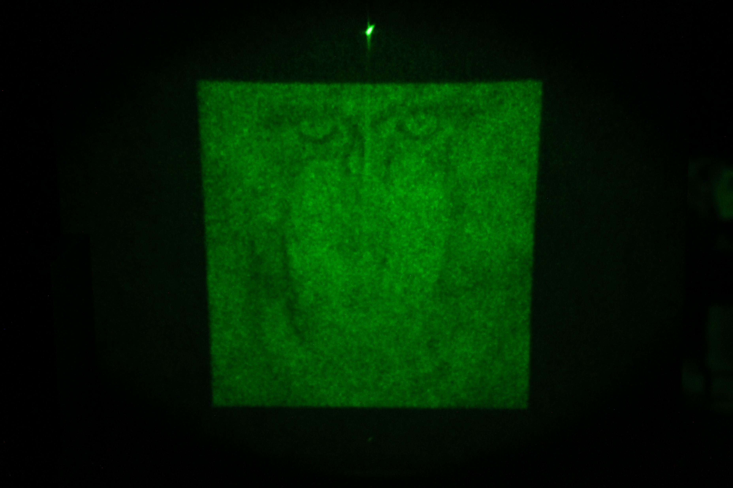
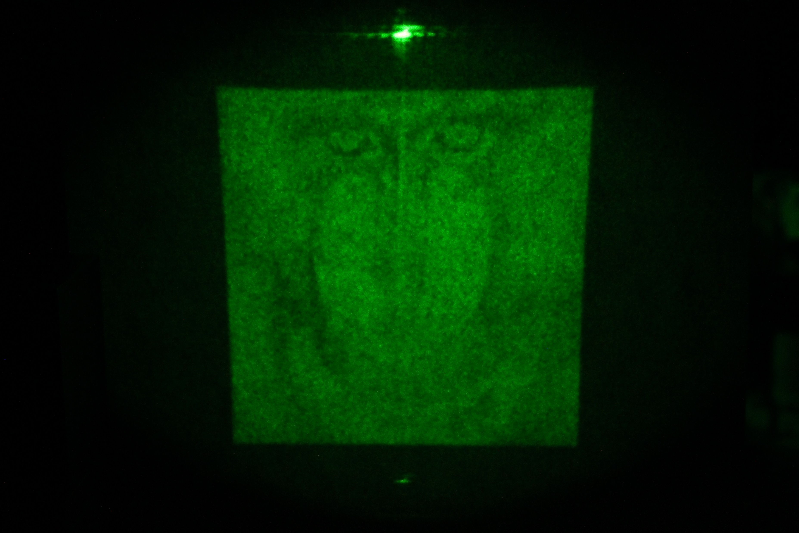
Target image
Multi frame optimisation
ADOSPR
[Ambigram by Ben]
[Mandrill]

Slide 8
Current status
Preliminary results
Better zero order suppression
Much slower runtime (tens of seconds as opposed to <1s of OSPR/ASOSPR)
Plan for next steps
Multi slice hologram generation using the multi-frame optimization method
Try projection onto steam
Got the risk assessment approved to bring the steam maker to lab 141.

Slide 9
3. Phase-only Computer-Generated Holograms (CGH)
From an Information Entropy Point of View
2023/10/31
Jinze Sha
Centre for Molecular Materials, Photonics and Electronics, University of Cambridge

Slide 10
What is entropy in information theory?
Draw a ball from the following bags:
2 red balls and 8 blue balls
9 red balls and 1 blue balls
5 red balls and 5 blue balls
3 red balls, 3 blue balls and 4 green balls
Which one has the maximum uncertainty?
The entropy is a quantity that lets us precisely answer questions like the one above.
[2018 R. Venkataramanan] Handout for CAM ENG IIA course 3F7: Information Theory and Coding

Slide 11
Example usage of entropy: data compression
Encode the text: HELLOWORLD
Char | N_occur | p | ASCII code(L=8) | p * L
H | 1 | 0.1 | 01001000 | 0.8
E | 1 | 0.1 | 01000101 | 0.8
L | 3 | 0.3 | 01001100 | 2.4
O | 2 | 0.2 | 01001111 | 1.6
W | 1 | 0.1 | 01010111 | 0.8
R | 1 | 0.1 | 01010010 | 0.8
D | 1 | 0.1 | 01000100 | 0.8
Sum | 10 | 1 |  | 8
ASCII code gives 8 bits/symbol, totalling 80 bits, can we do better?
[2018 R. Venkataramanan] Handout for CAM ENG IIA course 3F7: Information Theory and Coding

Slide 12
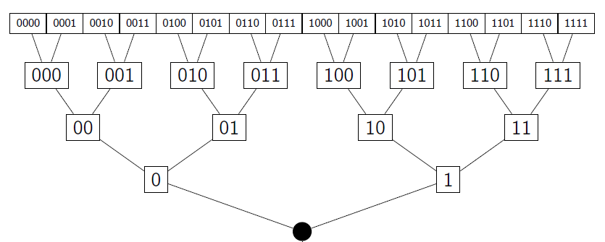
Example usage of entropy: data compression
Encode the text: HELLOWORLD
E
W
R
D
Char | N_occur | p | Code | L | p * L
H | 1 | 0.1 | 101 | 3 | 0.3
E | 1 | 0.1 | 1100 | 4 | 0.4
L | 3 | 0.3 | 0 | 1 | 0.3
O | 2 | 0.2 | 100 | 3 | 0.6
W | 1 | 0.1 | 1101 | 4 | 0.4
R | 1 | 0.1 | 1110 | 4 | 0.4
D | 1 | 0.1 | 1111 | 4 | 0.4
Sum | 10 | 1 |  |  | 2.8
O
H
L
My code (from top of my head) gives an expected code length of 2.8 bits/symbol
[2018 R. Venkataramanan] Handout for CAM ENG IIA course 3F7: Information Theory and Coding

Slide 13
Example usage of entropy: data compression
Encode the text: HELLOWORLD
H
0.1
Char | N_occur | p | Huffman code | L | p * L
H | 1 | 0.1 | 000 | 3 | 0.3
E | 1 | 0.1 | 001 | 3 | 0.3
L | 3 | 0.3 | 10 | 2 | 0.6
O | 2 | 0.2 | 01 | 2 | 0.4
W | 1 | 0.1 | 110 | 3 | 0.3
R | 1 | 0.1 | 1110 | 4 | 0.4
D | 1 | 0.1 | 1101 | 4 | 0.4
Sum | 10 | 1 |  |  | 2.7
0.2
E
0.1
0.4
L
0.3
1.0
O
0.2
0.6
W
0.1
0.3
R
0.1
0
0.2
D
0.1
1
Huffman coding gives an expected code length of 2.7 bits/symbol
[1952 D. A. Huffman] A Method for the Construction of Minimum-Redundancy Codes

Slide 14
Example usage of entropy: data compression
Encode the text: HELLOWORLD
Char | N_occur | p | -plog(p) | ASCII code | p * L | My code | p * L | Huffman code | p * L
H | 1 | 0.1 | 0.33219 | 01001000 | 0.8 | 101 | 0.3 | 000 | 0.3
E | 1 | 0.1 | 0.33219 | 01000101 | 0.8 | 1100 | 0.4 | 001 | 0.3
L | 3 | 0.3 | 0.52109 | 01001100 | 2.4 | 0 | 0.3 | 10 | 0.6
O | 2 | 0.2 | 0.46439 | 01001111 | 1.6 | 100 | 0.6 | 01 | 0.4
W | 1 | 0.1 | 0.33219 | 01010111 | 0.8 | 1101 | 0.4 | 110 | 0.3
R | 1 | 0.1 | 0.33219 | 01010010 | 0.8 | 1110 | 0.4 | 1110 | 0.4
D | 1 | 0.1 | 0.33219 | 01000100 | 0.8 | 1111 | 0.4 | 1101 | 0.4
Sum | 10 | 1 | 2.64644 |  | 8 |  | 2.8 |  | 2.7
H=2.64644 bits/symbol < 2.7 < 2.8 < 8
Entropy denotes the limit of lossless data compression (i.e. the amount of information carried)
[1948 C. E. Shannon] A Mathematical Theory of Communication

Slide 15
Motivation
Repeatedly compressing a file won’t keep making it smaller
Entropy denotes the limit of lossless data compression
(i.e. the amount of information carried)
A binary phase hologram (1-bit) cannot carry more than 1 bit/symbol
(i.e. hologram of size 512px*512px cannot contain more information than 1*512*512 = 262144 bits)
Any target image with entropy more than 1 bit/symbol will not have a perfect binary-phase hologram (of the same resolution)
Otherwise, we would make a lossless compressor breaking the entropy limit

Slide 16
Objective
Any target image with entropy more than 1 bit/symbol will not have a perfect binary-phase hologram (of the same resolution)
Otherwise, we would make a lossless compressor breaking the entropy limit
For any CGH algorithm:
If H_{CGH} <H_{target_image}
Then the reconstruction will certainly be lossy
BUT
Does CGH with higher bit depth have better reconstruction quality given the same target image?
Are images with higher entropy more difficult for CGH?

Slide 17
Method
Quantized Gerchberg-Saxton
Input initial phase hologram H
and target image T
Compute the reconstructed field E
E = FFT(e^{iH})
Apply Target amplitude constraint
E = T e^{i∠E}
Loop for N iterations
Output hologram H
Apply phase constraint
H = Quantize (∠A, bit_depth)
Compute the hologram plane
A = IFF(E)
At end of loop

Slide 18
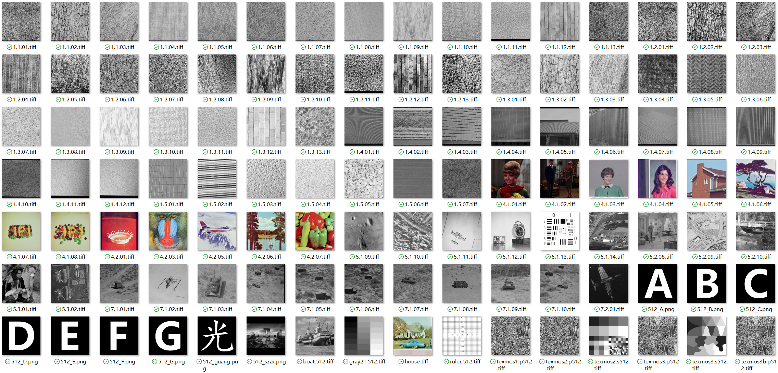
Dataset

Slide 19
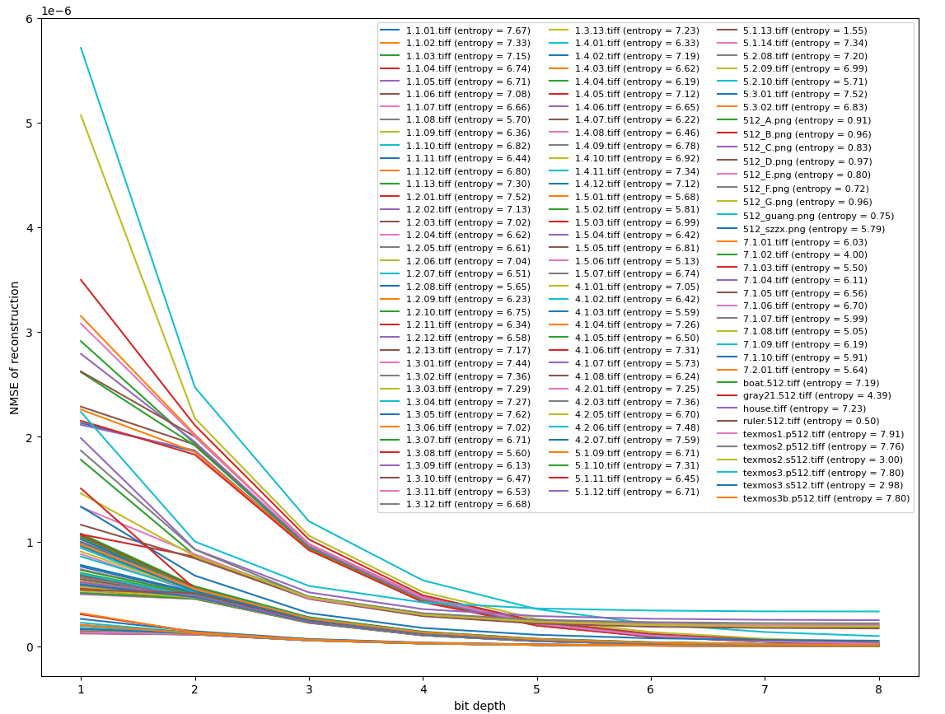
NMSE v.s. bit depth

Slide 20
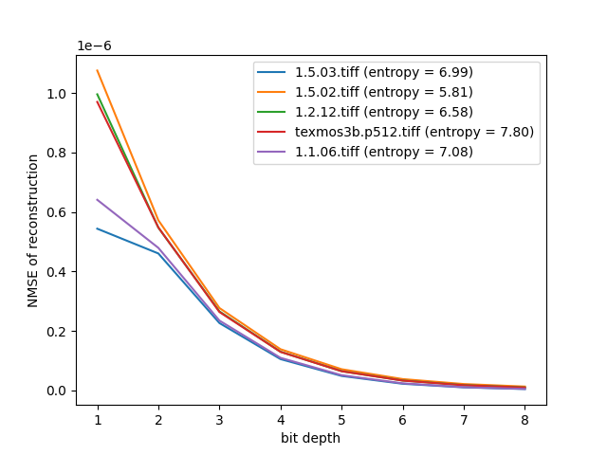
NMSE v.s. bit depth
Does CGH with higher bit depth have better reconstruction quality given the same target image? YES (for this dataset and GS algorithm)

Slide 21
Raw data for 5 runs per target image each with a random initial hologram
image_filename | image_entropy | bit_depth | NMSE | holo_entropy
1.1.01.tiff | 7.670242439 | 1 | 7.60E-07 | 0.999999344
1.1.01.tiff | 7.670242439 | 1 | 7.62E-07 | 0.999994345
1.1.01.tiff | 7.670242439 | 1 | 7.63E-07 | 0.999997205
1.1.01.tiff | 7.670242439 | 1 | 7.59E-07 | 0.999999501
1.1.01.tiff | 7.670242439 | 1 | 7.57E-07 | 0.999997602
1.1.01.tiff | 7.670242439 | 2 | 5.06E-07 | 1.999983375
1.1.01.tiff | 7.670242439 | 2 | 5.04E-07 | 1.999990182
1.1.01.tiff | 7.670242439 | 2 | 5.06E-07 | 1.999998375
1.1.01.tiff | 7.670242439 | 2 | 5.04E-07 | 1.999993068
1.1.01.tiff | 7.670242439 | 2 | 5.08E-07 | 1.99999316
1.1.01.tiff | 7.670242439 | 3 | 2.46E-07 | 2.999990259
1.1.01.tiff | 7.670242439 | 3 | 2.45E-07 | 2.999976125
1.1.01.tiff | 7.670242439 | 3 | 2.45E-07 | 2.999983929
1.1.01.tiff | 7.670242439 | 3 | 2.46E-07 | 2.99998347
1.1.01.tiff | 7.670242439 | 3 | 2.45E-07 | 2.999982049
1.1.01.tiff | 7.670242439 | 4 | 1.16E-07 | 3.999972098
1.1.01.tiff | 7.670242439 | 4 | 1.16E-07 | 3.999967494
1.1.01.tiff | 7.670242439 | 4 | 1.17E-07 | 3.999957025
1.1.01.tiff | 7.670242439 | 4 | 1.16E-07 | 3.999967088
1.1.01.tiff | 7.670242439 | 4 | 1.16E-07 | 3.999967331
image_filename | image_entropy | bit_depth | NMSE | holo_entropy
1.1.01.tiff | 7.670242439 | 5 | 5.56E-08 | 4.999938079
1.1.01.tiff | 7.670242439 | 5 | 5.55E-08 | 4.99988288
1.1.01.tiff | 7.670242439 | 5 | 5.56E-08 | 4.999894799
1.1.01.tiff | 7.670242439 | 5 | 5.57E-08 | 4.99992608
1.1.01.tiff | 7.670242439 | 5 | 5.55E-08 | 4.999949466
1.1.01.tiff | 7.670242439 | 6 | 2.68E-08 | 5.999836573
1.1.01.tiff | 7.670242439 | 6 | 2.68E-08 | 5.999803418
1.1.01.tiff | 7.670242439 | 6 | 2.68E-08 | 5.999824461
1.1.01.tiff | 7.670242439 | 6 | 2.69E-08 | 5.999811604
1.1.01.tiff | 7.670242439 | 6 | 2.68E-08 | 5.999873257
1.1.01.tiff | 7.670242439 | 7 | 1.31E-08 | 6.999696431
1.1.01.tiff | 7.670242439 | 7 | 1.31E-08 | 6.999634812
1.1.01.tiff | 7.670242439 | 7 | 1.30E-08 | 6.99965406
1.1.01.tiff | 7.670242439 | 7 | 1.32E-08 | 6.999612686
1.1.01.tiff | 7.670242439 | 7 | 1.31E-08 | 6.999653245
1.1.01.tiff | 7.670242439 | 8 | 6.51E-09 | 7.999260416
1.1.01.tiff | 7.670242439 | 8 | 6.49E-09 | 7.999198801
1.1.01.tiff | 7.670242439 | 8 | 6.53E-09 | 7.999304965
1.1.01.tiff | 7.670242439 | 8 | 6.53E-09 | 7.99936897
1.1.01.tiff | 7.670242439 | 8 | 6.51E-09 | 7.999241393
Entropy of hologram is very close to but less than the bit depth
5 runs with different random initial phase don’t make much difference

Slide 22
Raw data for 5 runs per target image each with a random initial hologram
image_filename | image_entropy | bit_depth | NMSE | holo_entropy
ruler.512.tiff | 0.500032851 | 1 | 5.39E-07 | 0.999999279
ruler.512.tiff | 0.500032851 | 1 | 5.41E-07 | 0.999999996
ruler.512.tiff | 0.500032851 | 1 | 5.39E-07 | 0.999998925
ruler.512.tiff | 0.500032851 | 1 | 5.42E-07 | 0.999999153
ruler.512.tiff | 0.500032851 | 1 | 5.38E-07 | 0.999999988
ruler.512.tiff | 0.500032851 | 2 | 5.07E-07 | 1.999999454
ruler.512.tiff | 0.500032851 | 2 | 5.05E-07 | 1.99998913
ruler.512.tiff | 0.500032851 | 2 | 5.06E-07 | 1.999996821
ruler.512.tiff | 0.500032851 | 2 | 5.07E-07 | 1.999997775
ruler.512.tiff | 0.500032851 | 2 | 5.07E-07 | 1.999990571
ruler.512.tiff | 0.500032851 | 3 | 2.46E-07 | 2.999991798
ruler.512.tiff | 0.500032851 | 3 | 2.47E-07 | 2.999996141
ruler.512.tiff | 0.500032851 | 3 | 2.49E-07 | 2.99999543
ruler.512.tiff | 0.500032851 | 3 | 2.47E-07 | 2.999992958
ruler.512.tiff | 0.500032851 | 3 | 2.47E-07 | 2.999997259
ruler.512.tiff | 0.500032851 | 4 | 1.18E-07 | 3.999986376
ruler.512.tiff | 0.500032851 | 4 | 1.18E-07 | 3.999959011
ruler.512.tiff | 0.500032851 | 4 | 1.18E-07 | 3.999948797
ruler.512.tiff | 0.500032851 | 4 | 1.18E-07 | 3.999968357
ruler.512.tiff | 0.500032851 | 4 | 1.18E-07 | 3.999963972
image_filename | image_entropy | bit_depth | NMSE | holo_entropy
ruler.512.tiff | 0.500032851 | 5 | 5.72E-08 | 4.999935046
ruler.512.tiff | 0.500032851 | 5 | 5.75E-08 | 4.999886001
ruler.512.tiff | 0.500032851 | 5 | 5.72E-08 | 4.999944959
ruler.512.tiff | 0.500032851 | 5 | 5.70E-08 | 4.999932181
ruler.512.tiff | 0.500032851 | 5 | 5.71E-08 | 4.999920056
ruler.512.tiff | 0.500032851 | 6 | 2.86E-08 | 5.999854993
ruler.512.tiff | 0.500032851 | 6 | 2.84E-08 | 5.999813055
ruler.512.tiff | 0.500032851 | 6 | 2.86E-08 | 5.999753206
ruler.512.tiff | 0.500032851 | 6 | 2.83E-08 | 5.999815487
ruler.512.tiff | 0.500032851 | 6 | 2.86E-08 | 5.999874399
ruler.512.tiff | 0.500032851 | 7 | 1.48E-08 | 6.999654227
ruler.512.tiff | 0.500032851 | 7 | 1.47E-08 | 6.999694163
ruler.512.tiff | 0.500032851 | 7 | 1.48E-08 | 6.99962287
ruler.512.tiff | 0.500032851 | 7 | 1.47E-08 | 6.999651519
ruler.512.tiff | 0.500032851 | 7 | 1.48E-08 | 6.999657836
ruler.512.tiff | 0.500032851 | 8 | 8.16E-09 | 7.999211823
ruler.512.tiff | 0.500032851 | 8 | 8.18E-09 | 7.999328302
ruler.512.tiff | 0.500032851 | 8 | 8.16E-09 | 7.999185162
ruler.512.tiff | 0.500032851 | 8 | 8.05E-09 | 7.9992535
ruler.512.tiff | 0.500032851 | 8 | 8.16E-09 | 7.99927939
For the image with small entropy, higher bit depth is still getting leading to better result

Slide 23
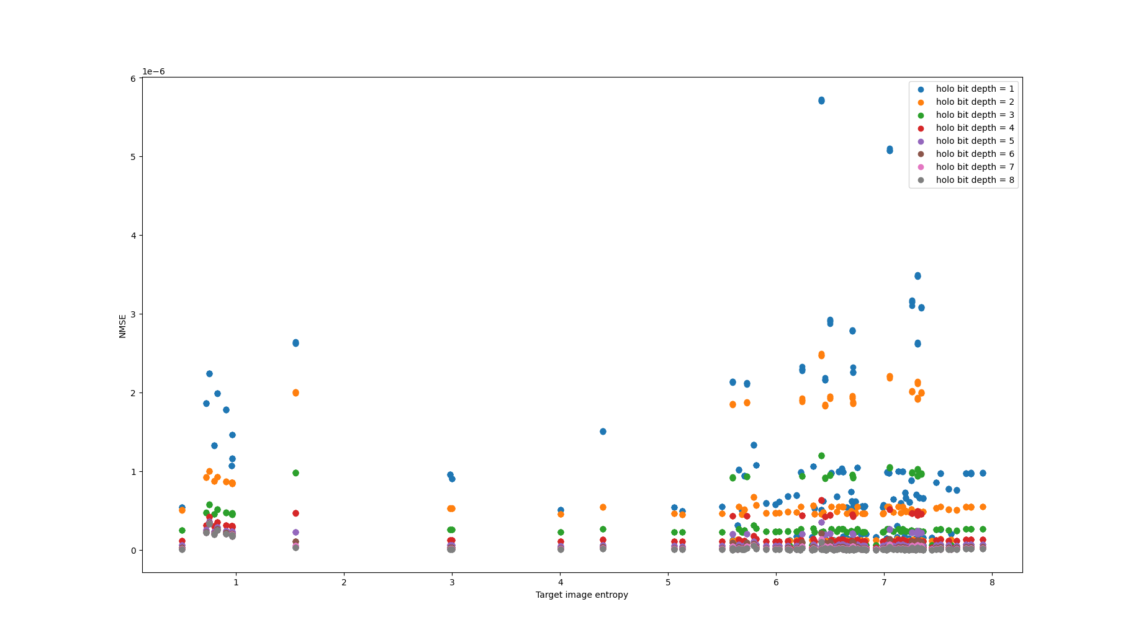








Scatter plot: NMSE v.s. Entropy (5 runs per target image each with a random initial hologram)

Slide 24
Scatter plot: NMSE v.s. Entropy (5 runs per target image each with a random initial hologram)
Are images with higher entropy more difficult for CGH?
Not necessarily

Slide 25
Preliminary Results
Does CGH with higher bit depth have better reconstruction quality given the same target image?
YES (for this dataset and GS algorithm)
Are images with higher entropy more difficult for CGH?
Not necessarily

Slide 26
Thank you for listening

